Slide 1
DSC-520 Final Project Covid India and vaccination Analysis
Vasanthakumar Kalaikkovan
Bellevue University

Slide 2
Outline of the analysis
In recent days, the COVID second wave is spreading a lot in the Asia region, especially in India.
The COVID positive cases are surging like 200 thousand cases per day which makes severe pandemic over there. The Indian government is taking a lot of precautionary measures to control the situation by imposing a curfew, partial lockdowns, etc also, the government has sped up the process of producing a vaccine for COVID like Covaxin and Covid-shield.
Since this situation is important for all of us to know, I would like to use this chance to analyze the situation of the first wave of COVID pandemic and the second wave of the pandemic in India.
For this final term project, I will be analysing the pandemic situation in India from Jan 2020 through to date.

Slide 3
Variables in the Dataset
Date.
States.
The number of positive cases.
The number of deaths.
The number of persons vaccinated.
The number of persons recovered.

Slide 4
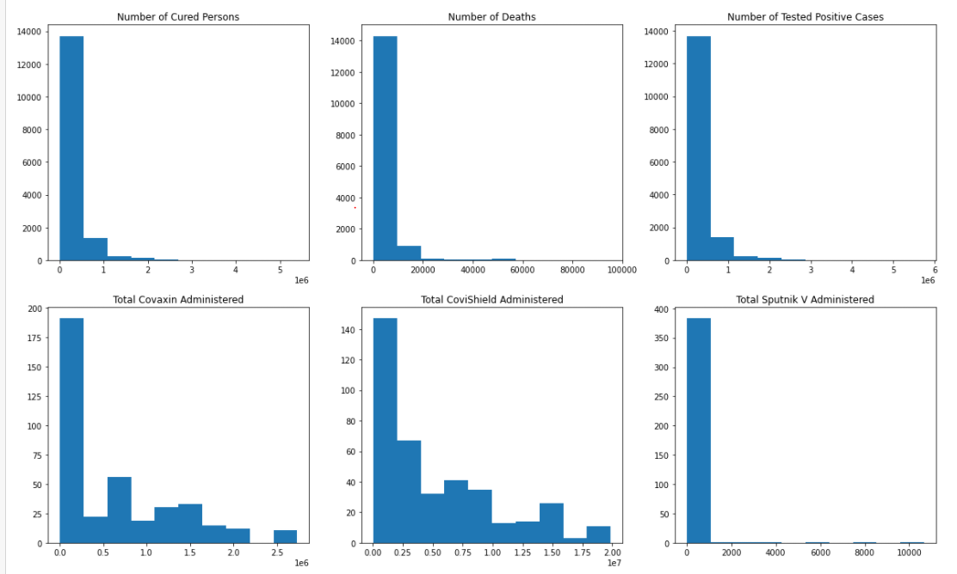
Histograms
Since this is the covid pandemic data, there is no outlier in the dataset because this data has been provided by the world meter and there is an increasing cases everyday.

Slide 5
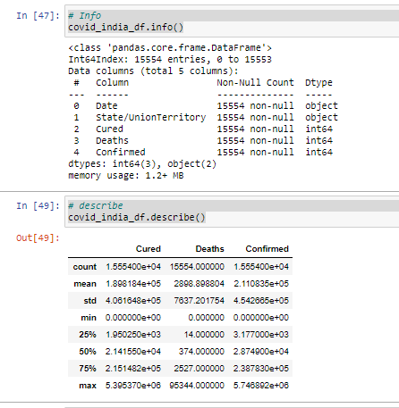
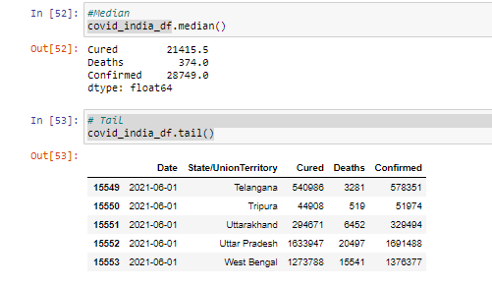
Mean, Mode, Spread, and Tails

Slide 6
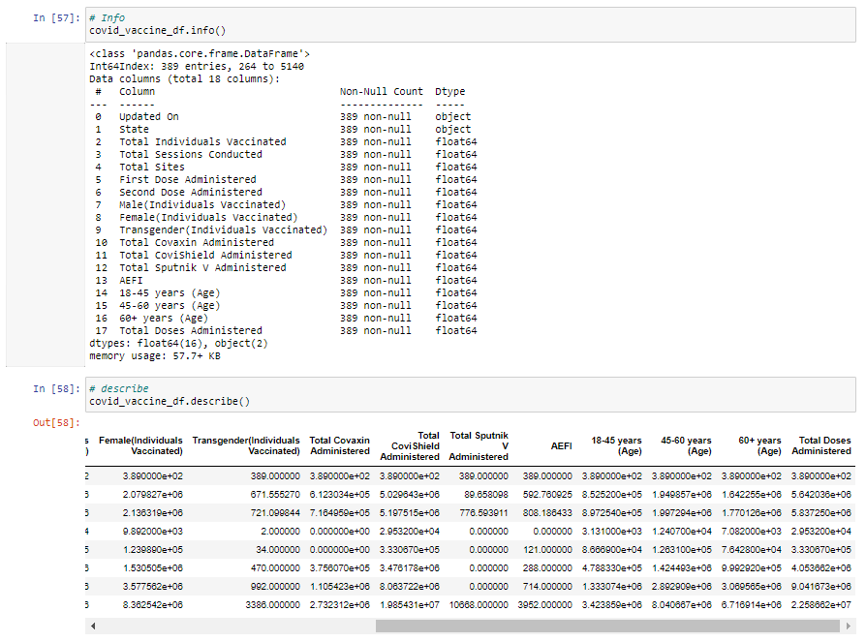
Mean, Mode, Spread, and Tails

Slide 7
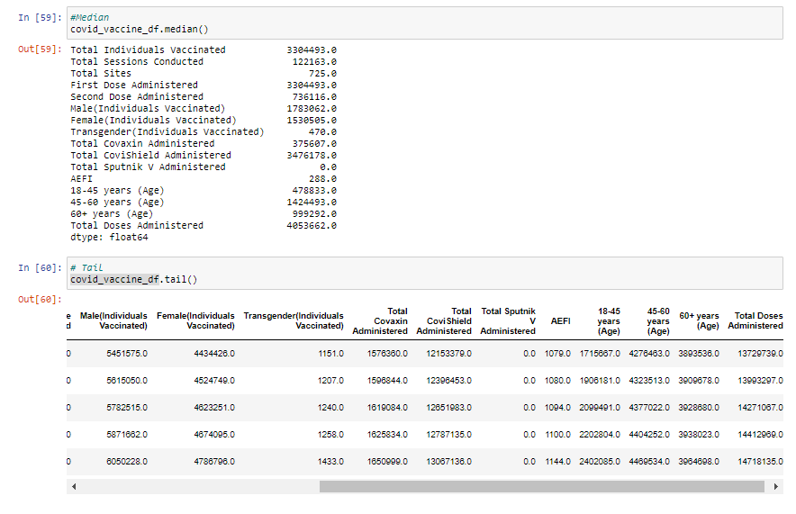
Mean, Mode, Spread, and Tails

Slide 8
Mean, Mode, Spread, and Tails

Slide 9
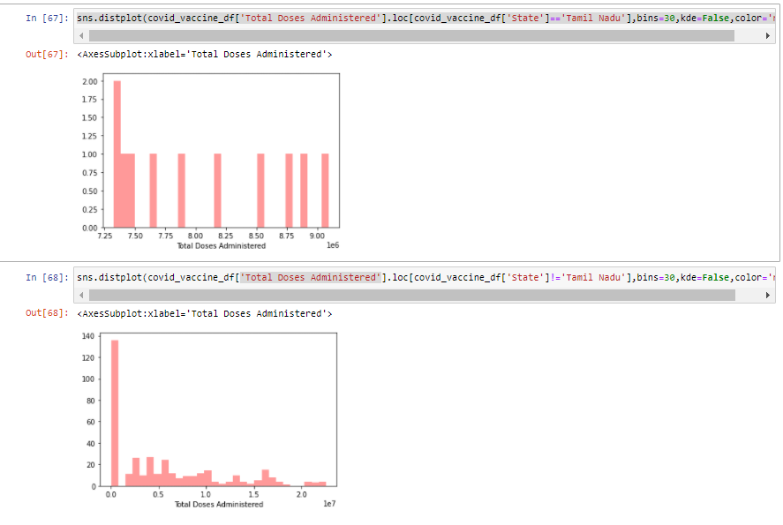
PMF of one State vs all other states

Slide 10
PMF of one State vs all other states

Slide 11
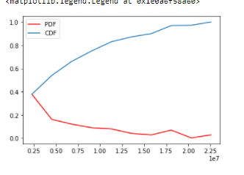
CDF
Here the CDF returns the probability of “Total Doses Administered” value is less than to the given value.

Slide 12
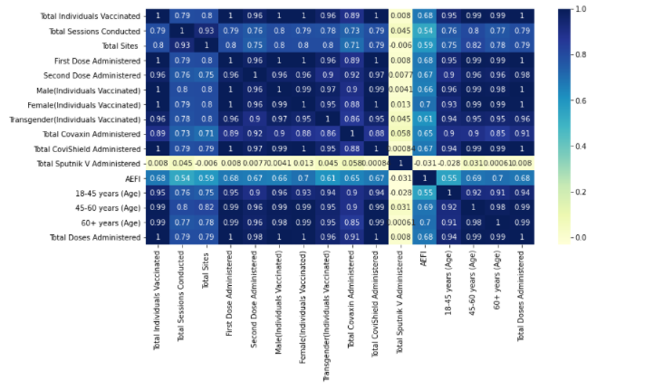
Analytical distribution
From the heat map shown above most of the correlations are positive only because everyday the vaccination is increasing in each state.
But there is outlier of Sputnik vaccine because its not available in India

Slide 13
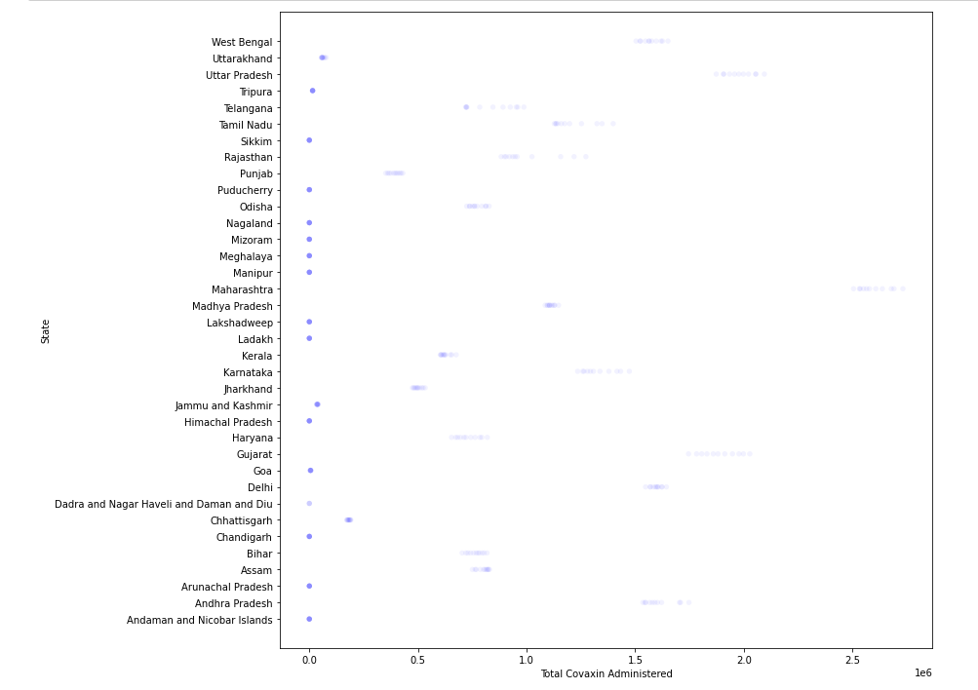
Scatter plot Total Covaxin vaccinated vs State
This scatter plot shows that each states are equally vaccinate and this is because of the vaccination drive is conducted by central government and they are distributing the vaccine equally

Slide 14
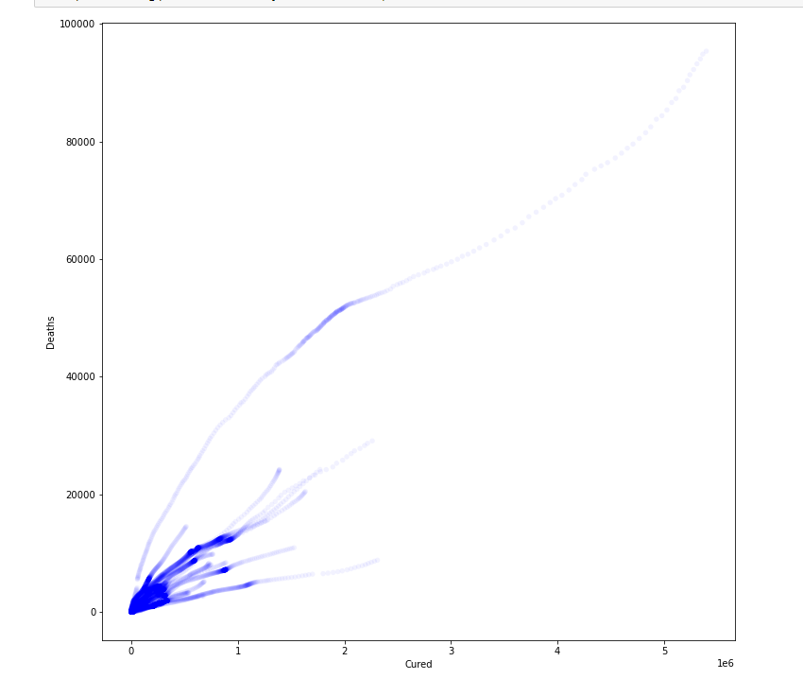
Scatter plot Total Deaths vs Cured
This scatter plot shows that the death and cure are equally distributed are increased due to increasing number of cases

Slide 15
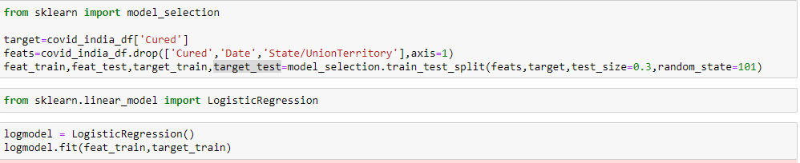
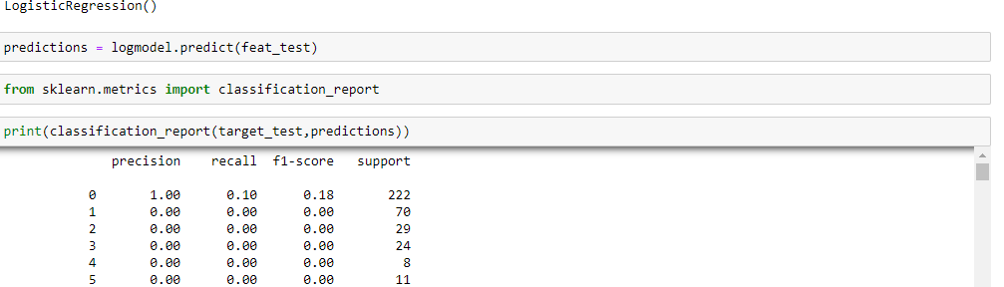
Regression analysis
As per the regression analysis on the variable “Cured”, the data seems to be the same and cant find any outliers or any flaws in it.

Slide 16
Thank you

